Slide 1
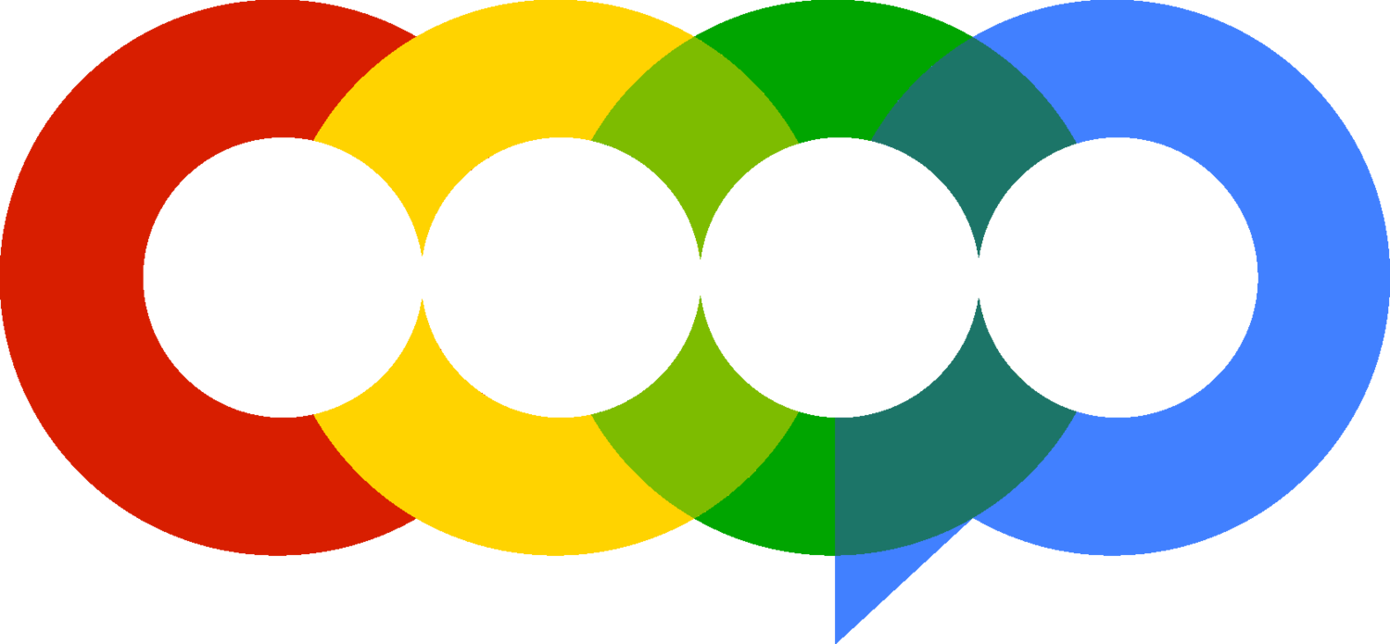


Slide 2
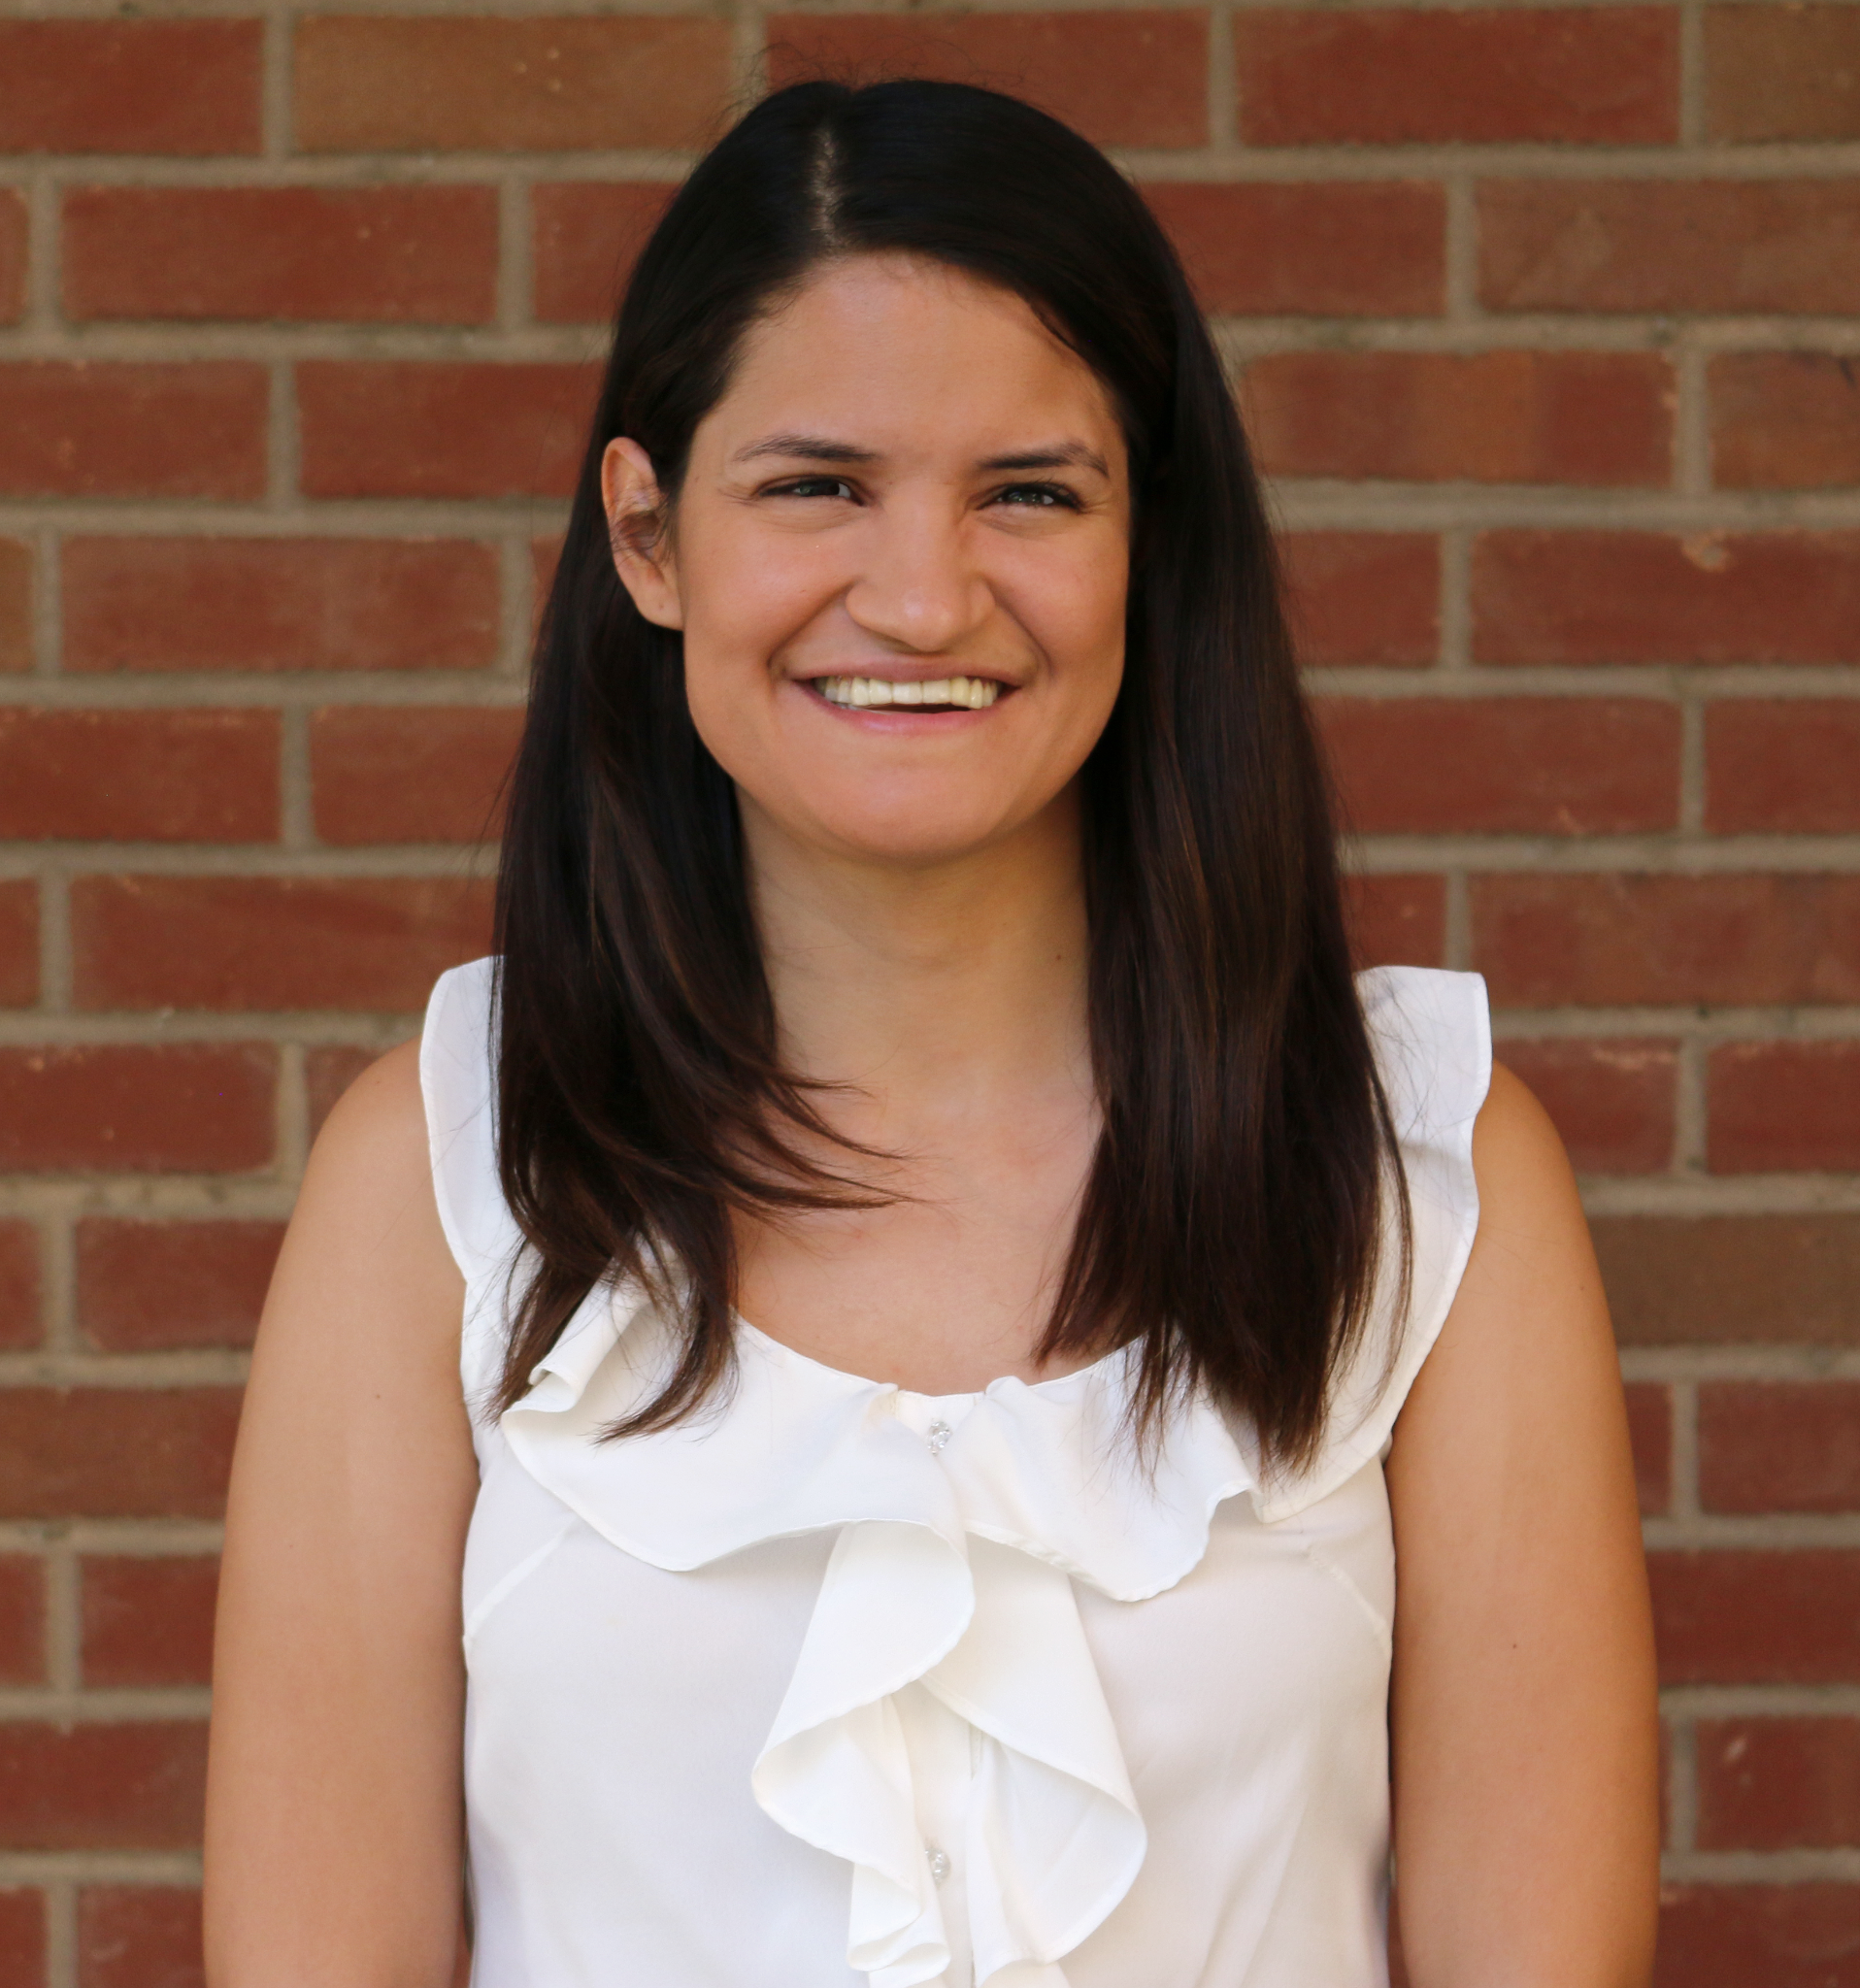

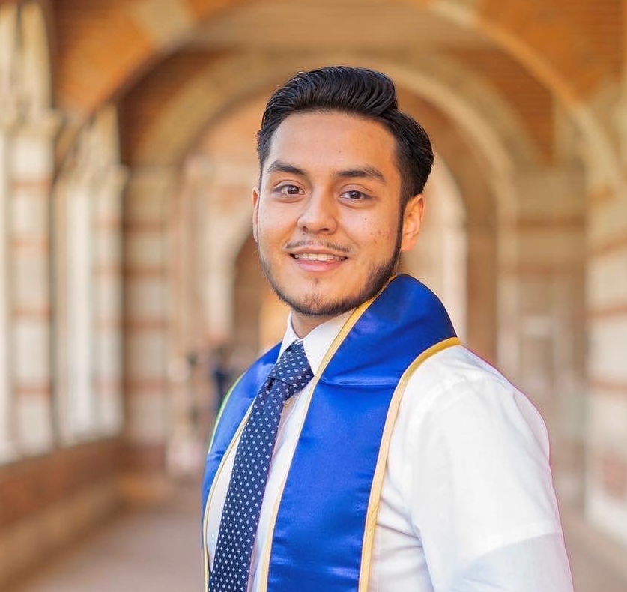
Meet the team
Carolina Garcia
Kevin Nguyen
Edwin Zamora
Spatial Analyst
Creative Analyst
Audience Analyst

Slide 3
Agenda
1
Introduction – Methods,Terminology
2
Key Findings – Spatial, Audience, & Creative
3
Conclusion – Summary and Recommendations

Slide 4
Introduction
Founded in 2025
B2B Marketing Agency that helps other marketing agencies enhance online visibility.
We leverage data-driven analysis to develop tailored solutions and strategies that drive profitability.

Slide 5
Context & Goals
Our client, a telecommunications company, needs our expertise to analyze their ad campaign data to maximize their future spatial, creative, and audience advertising strategies.
The clients goals are to:
Decrease Cost-Per-Acquisition (CPA) to $250 for Audiences
Decrease CPA to $350 for Desktop conversion
Decrease CPA to $400 for Smartphone conversion
Increase Viewability to 60%

Slide 6
Terminology & KPIs
Cost-Per-Acquisition (CPA) | How much money you spend to get one new customer to buy something from an ad. | LOWER is better
Cost-Per-Mille (CPM) | How much money you pay to show an ad to 1,000 people. | LOWER is better
Cost-Per-Viewable-Mille (vCPM) | How much money you pay to show an ad that had a reasonable chance of being seen by 1,000 people. | LOWER is better
Cost-Per-Click (CPC) | How much you pay every time someone clicks on your ad. | LOWER is better
Click-Through-Rate (CTR) | The percentage of people who see your ad and then click on it. | HIGHER is better
Conversion Rate (CVR) | The percentage of people who take a desired action after seeing your ad, like buying something. | HIGHER is better

Slide 7
Methodology
Dataset | PBL Design DA
Data Cleaning | Excel
Data Visualization | Tableau

Slide 8
Executive Summary
300x250 is the best creative size that spans across all devices (Smartphone, Windows PC, Apple PC) with low costs.
320x50 is the best creative size that focused exclusively on Smartphone with overall low costs and great viewable impression.
Overall, Brand Propensities was the best performing Audience Segment
Regions with higher viewable impressions generally had better branding and performance metrics
Notes:
Vivian

Slide 9
Spatial Analysis
Goal type | Primary goal | Secondary goal
Viewability | 60% | $80 vCPM

Slide 10
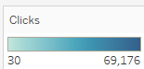
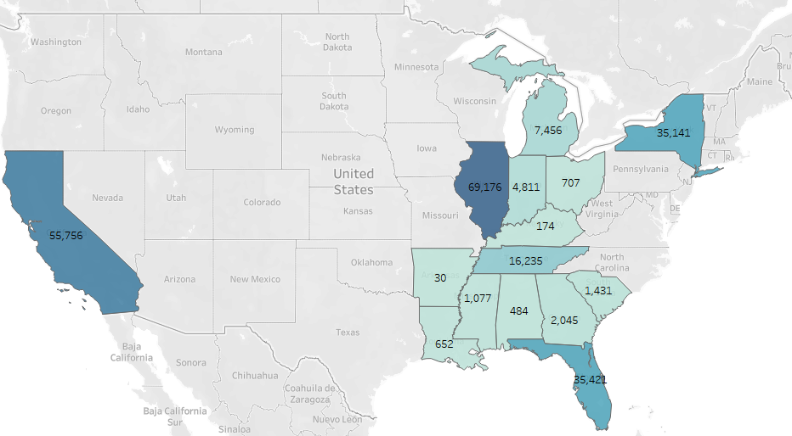
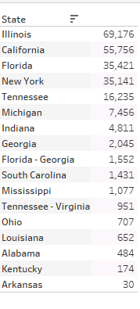
Clicks

Slide 11
Performance Metrics
CPA
CVR
CPC
CPM

Slide 12
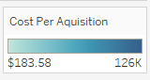
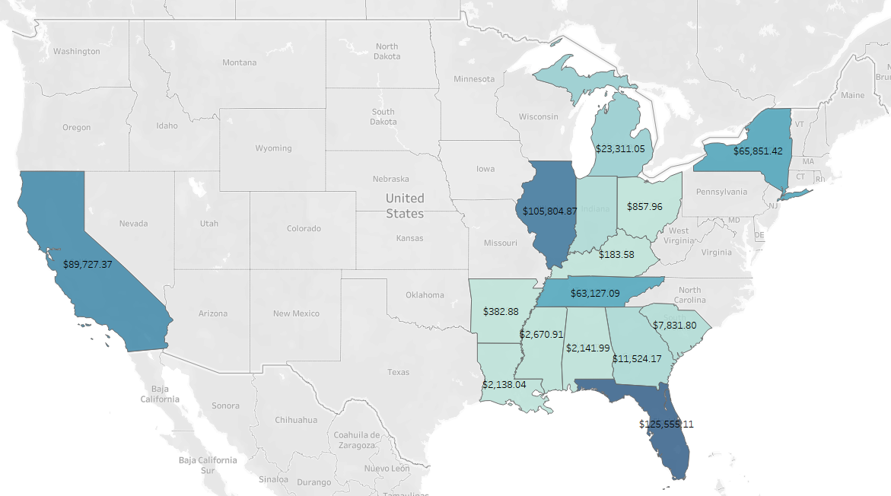
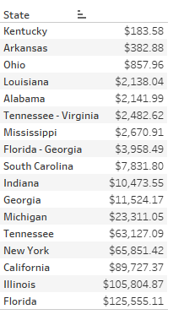
Cost-Per-Action (CPA)
:

Slide 13
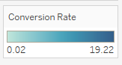
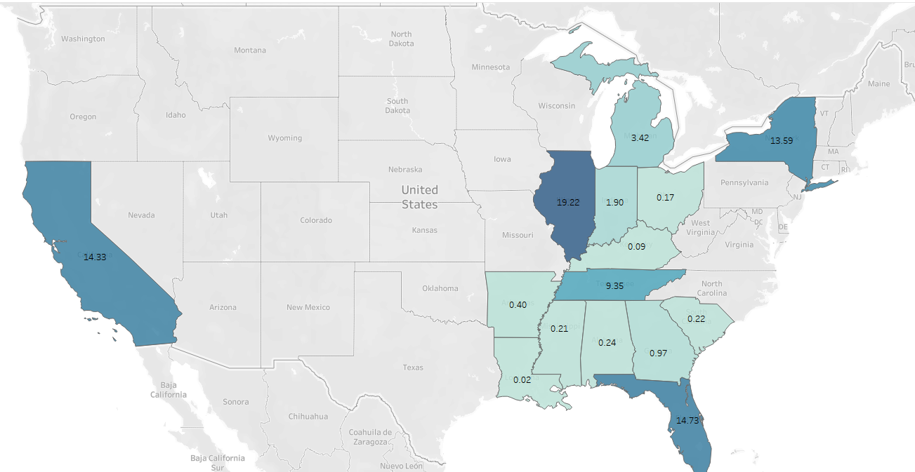
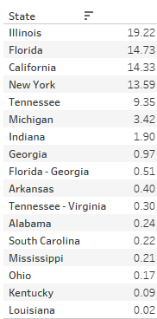
Conversion Rate (CVR) %

Slide 14
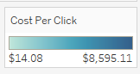
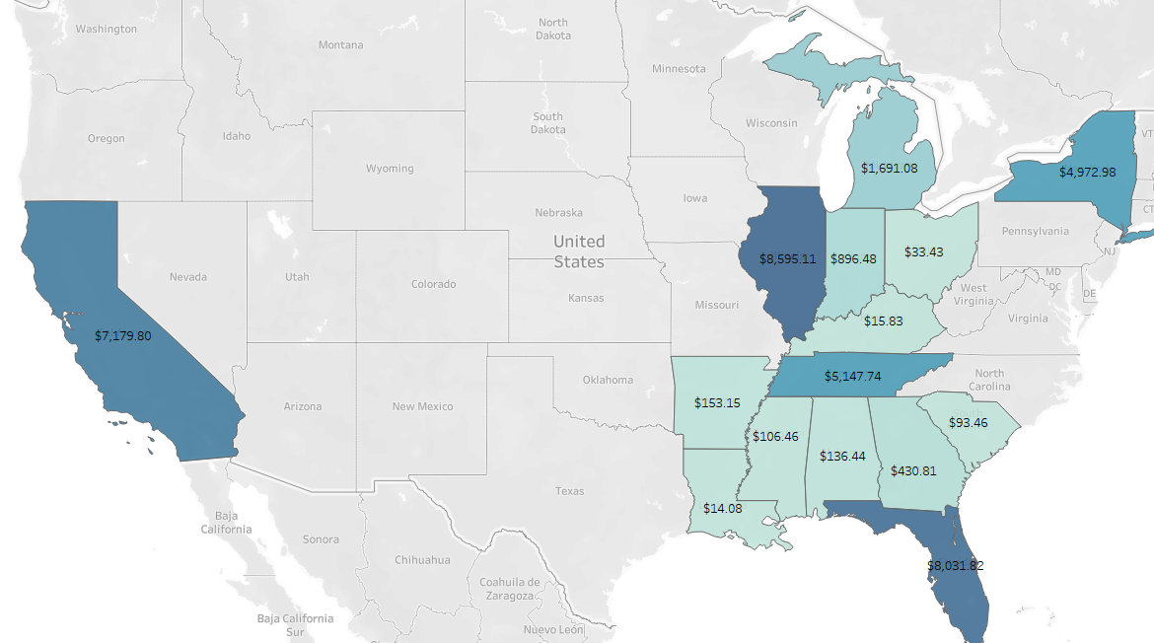
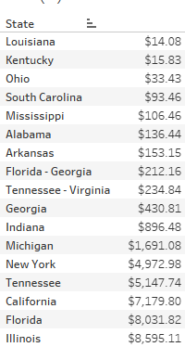
Cost-Per-Click (CPC)

Slide 15
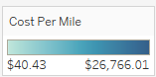
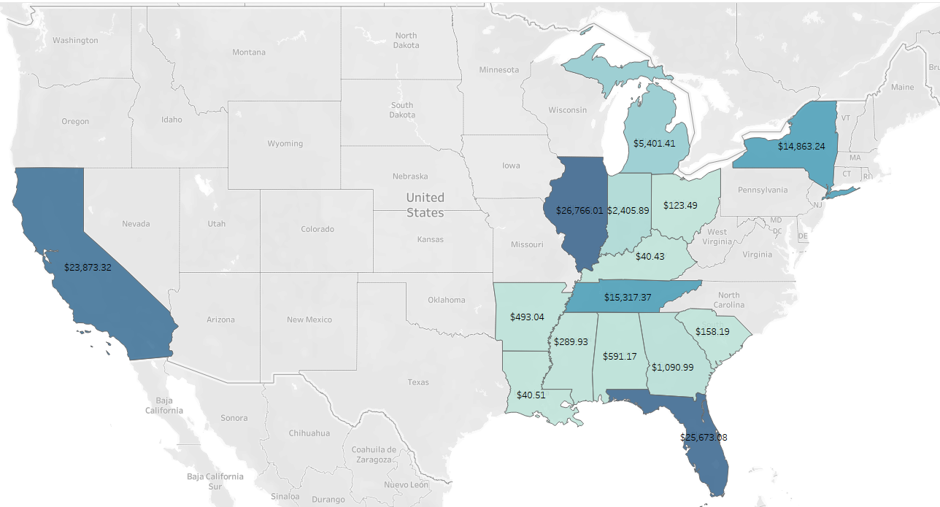
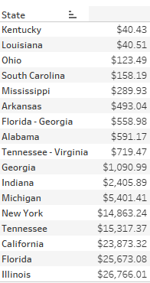
Cost-Per-Mile (CPM)

Slide 16
Branding Metrics
CTR
Viewability
Viewability Impressions

Slide 17
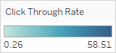
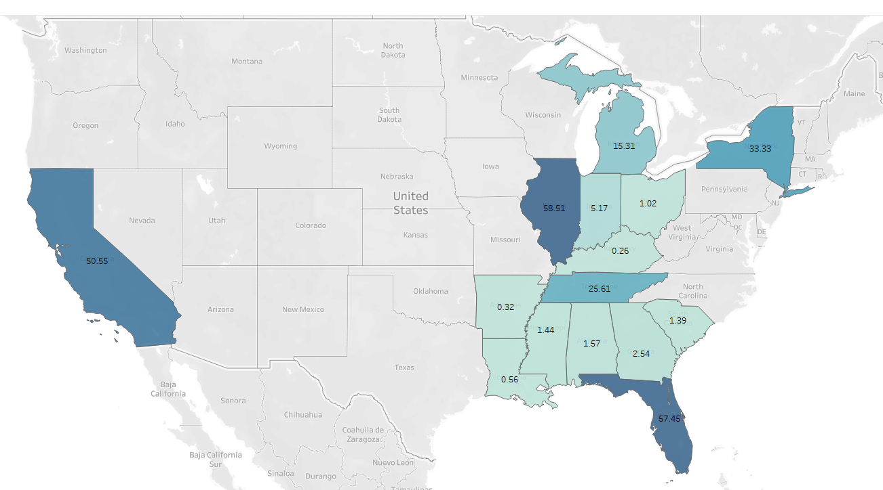
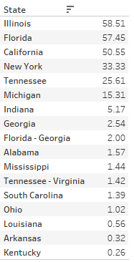
Click-Through-Rate (CTR) %

Slide 18
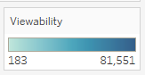
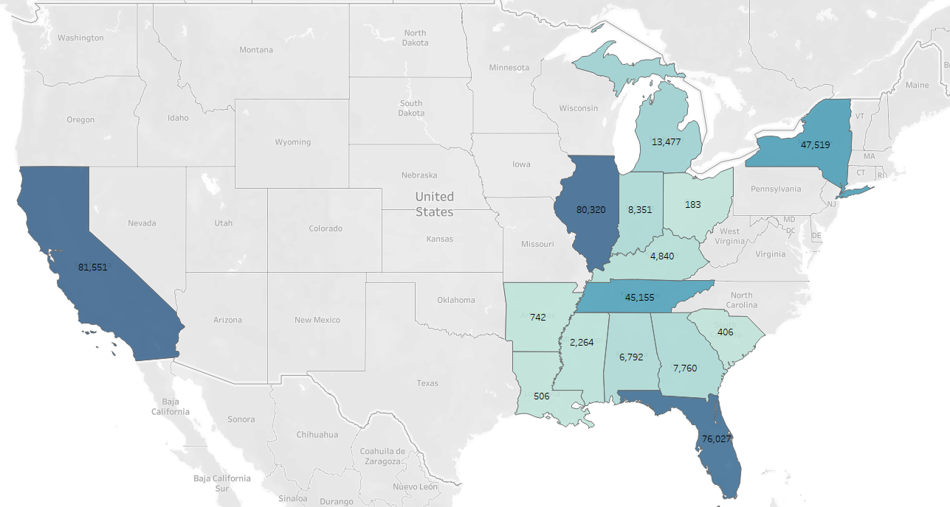
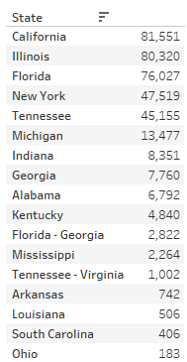
Viewability

Slide 19
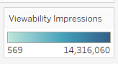
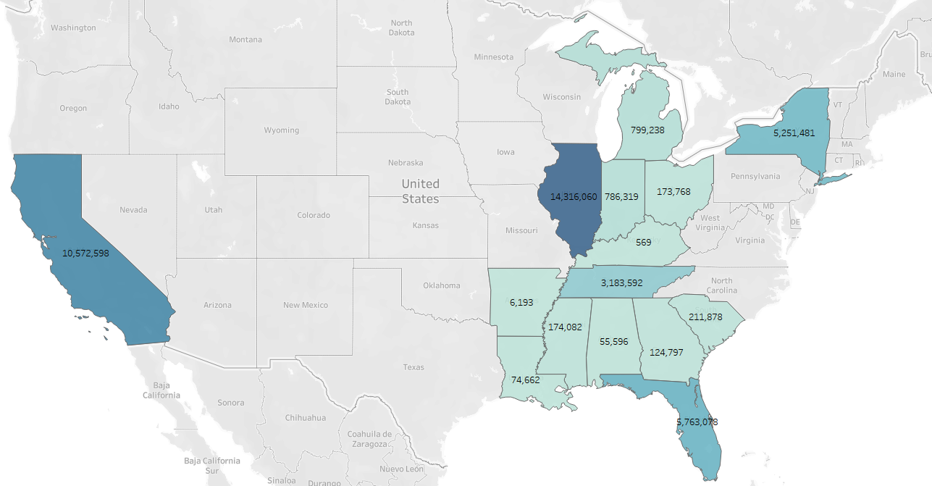
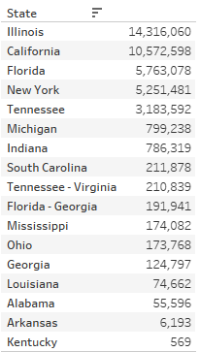
Viewable Impressions

Slide 20
Audience Analysis

Slide 21
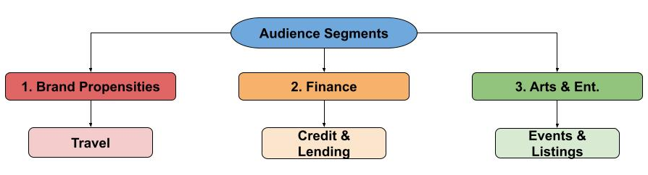
On average, audiences interested in Brand Propensity, Finance, and Arts/Ent. are more likely to convert.
* data by avg. conversions
Notes:
Audience segments and their subordinate characteristics that had the highest average conversions

Slide 22
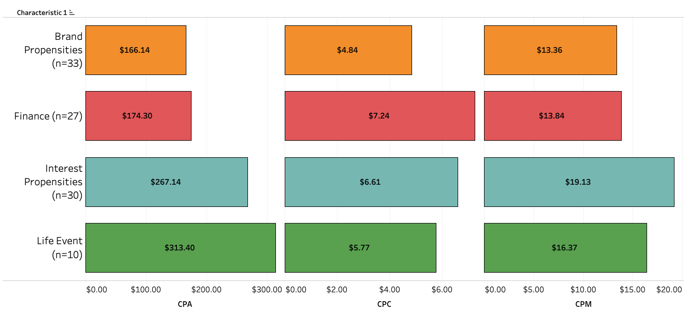
Performance Metrics
Notes:
Brand Propensity was the best overall performing segment. Followed by Finance, Interest Propensity, and Life Event.
Segments are ordered by their CPA but as you can see, these segments do no perform equally across all performance metrics.
All except life event meet the clients CPA goal of spending less than $250
To determine top performers, only audience segments with more than 10 targeted campaigns were analyzed
There were 56 audience segments that did not reach this threshold

Slide 23
Performance Metrics
Audience Segment | CPA
Brand Propensities | $166.14
Finance | $174.30
Mobile | $203.17
Sociodem. | $226.91
OnAudience | $237.67
Media & Ent. | $240.49
Lotame | $250.26
Interest Propensities | $267.14
Financial | $274.61
Travel | $297.00
Audience Segment | CPC
Brand Propensities | $4.84
Life Event | $5.77
Interest Propensities | $6.61
Finance | $7.24
Lotame | $8.77
Beauty and Fitness | $9.07
Sociodem. | $9.11
Media & Ent. | $9.88
The Changing Consumer | $10.58
Mobile | $10.64
Audience Segment | CPM
Brand Propensities | $13.36
Finance | $13.84
Life Event | $16.37
Interest Propensities | $19.13
Sociodemographic | $25.79
Lotame | $27.17
Beauty and Fitness | $28.31
The Changing Consumer | $29.25
Mobile | $30.57
Sports | $31.07
Notes:
Brand Propensity was the best overall performing segment. Followed by Life Event, Interest Propensity, and Finance.

Slide 24
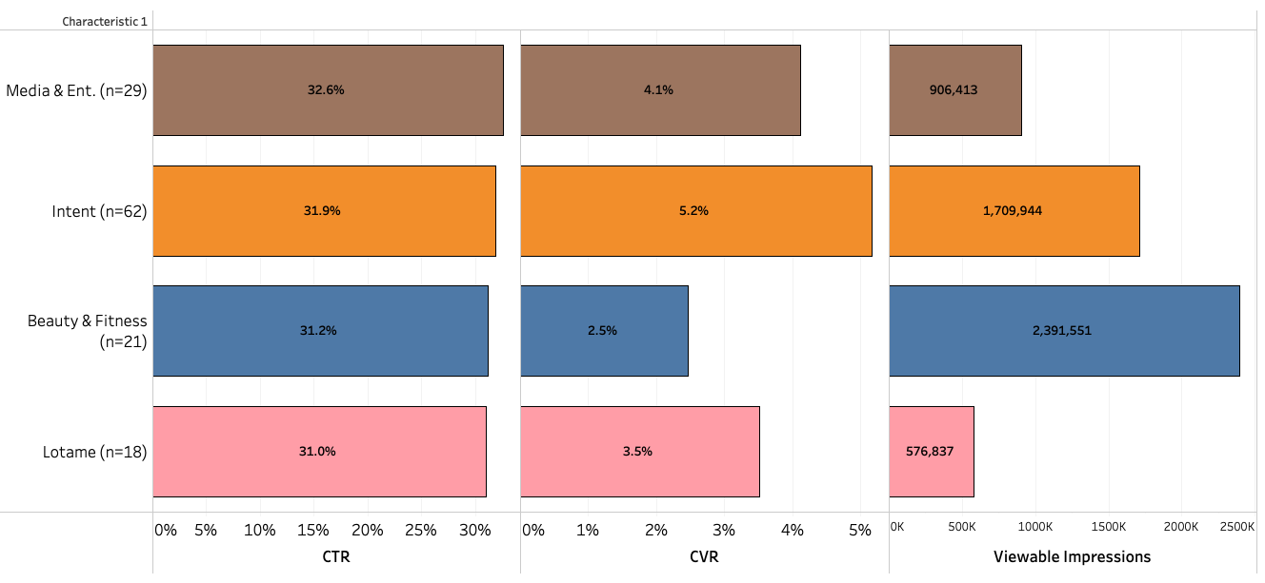
Engagement & Intent
Notes:
Engagement and Intent refer are desired outcomes that result from creative messaging.
We gauged user engagement and intent through performance and branding metrics listed on screen.
Combining CTR and CVR helps us understand not just who’s clicking, but who’s meaningfully engaging.
As you can see, Media & Ent. had a strong CTR which didn’t necessarily correspond to a equally strong CVR
In fact, audiences (Low tah me, pink) with fewer targeted campaigns, a smaller CTR, and less impressions still had a similar CVR
These differences may suggest issues with post-click experience, audience intent, or even viewability quality.

Slide 25
Engagement & Intent
Audience Segment | CTR
Media and Entertainment | 32.56%
Intent | 31.93%
Beauty and Fitness | 31.21%
Lotame | 30.98%
OnAudience | 30.76%
Reach | 29.38%
Interest Propensities | 28.96%
Autos and Vehicles | 28.81%
Mobile | 28.73%
Life Event | 28.37%
Audience Segment | CVR
Financial | 5.34%
Mobile | 5.24%
Intent | 5.16%
OnAudience | 4.89%
Arts and Entertainment | 4.82%
Travel | 4.38%
Finance | 4.15%
Media and Entertainment | 4.11%
Sociodemographic | 4.01%
B2B | 3.96%
Notes:
Engagement and Intent are desired outcomes that result from creative messaging.
We gauged user engagement and intent through performance and branding metrics listed on screen.
Combining CTR and CVR helps us understand not just who’s clicking, but who’s meaningfully engaging.
As you can see, Media & Ent. had a strong CVR which didn’t necessarily correspond to a equally strong CVR
In fact, audiences (Low tah me) with fewer targeted campaigns. a smaller CTR, and less impressions still had a similar CVR
These differences may suggest issues with post-click experience, audience intent, or even viewability quality.

Slide 26

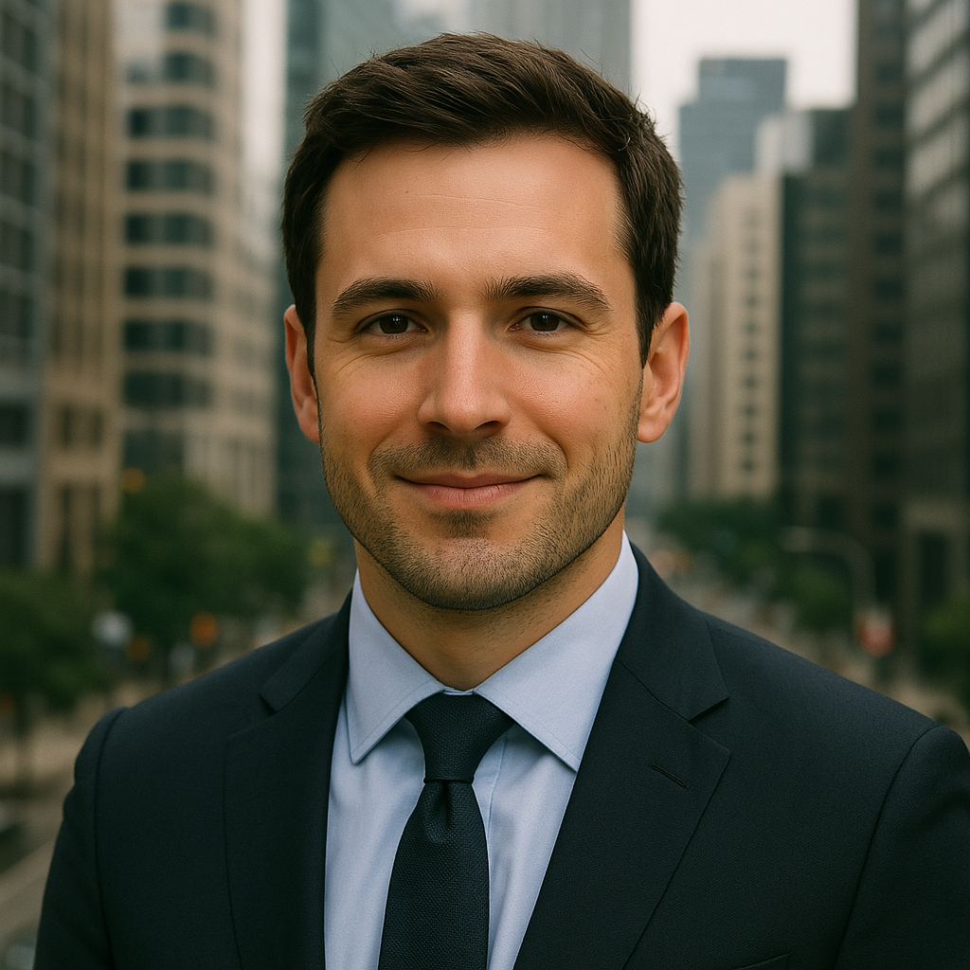

Name: Hotel Helen
Gender: Female¹
Age: 25-45¹
Location: Florida
Interests: Traveling, Hotel Hopping
Name: Finance Frank
Gender: Male²
Age: 40+³
Location: Illinois
Interests: Financial Literacy & Investing
Name: Artsy Ana
Gender: Female⁴
Age: 18 to 35⁴
Location: California
Interests: Live Events & Nightlife
*Images are AI generated
Sources: Hotel Booking Trend(2017)¹, Debt & Investing(2025⁾², Credit Card Trends(2022)³, Festival Demographic Trends (2023)⁴
Notes:
The audience personas were created by first seeing the full audience segment and location with highest conversions which saw at the beginning of this section The demographic details are based on the most recent US trends in their respective sectors

Slide 27
Creative Analysis
Kevin Nguyen

Slide 28
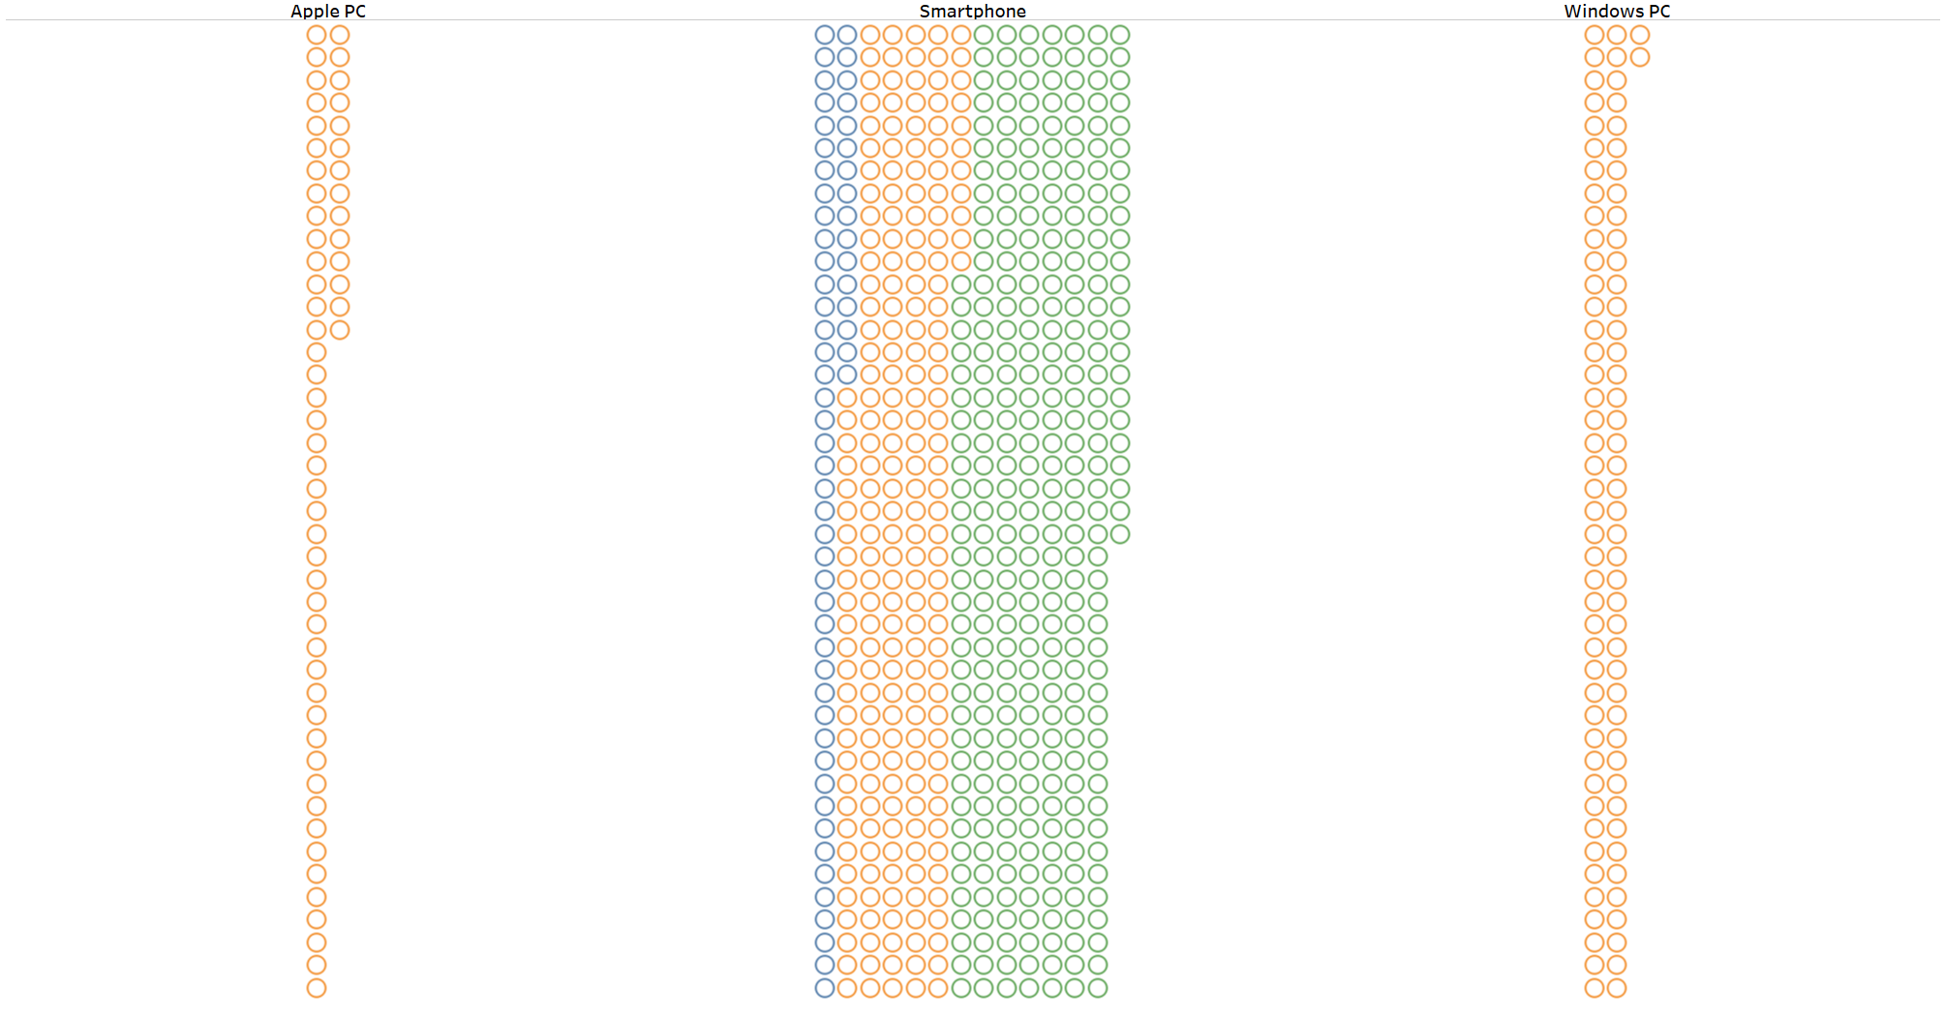
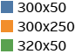
Smartphone devices support all creative sizes.
Notes:
We can see that all creative sizes are available on smartphones. Also, we should keep in mind that 300x250 is widely available for all of our device make, and it will come in handy later on.

Slide 29
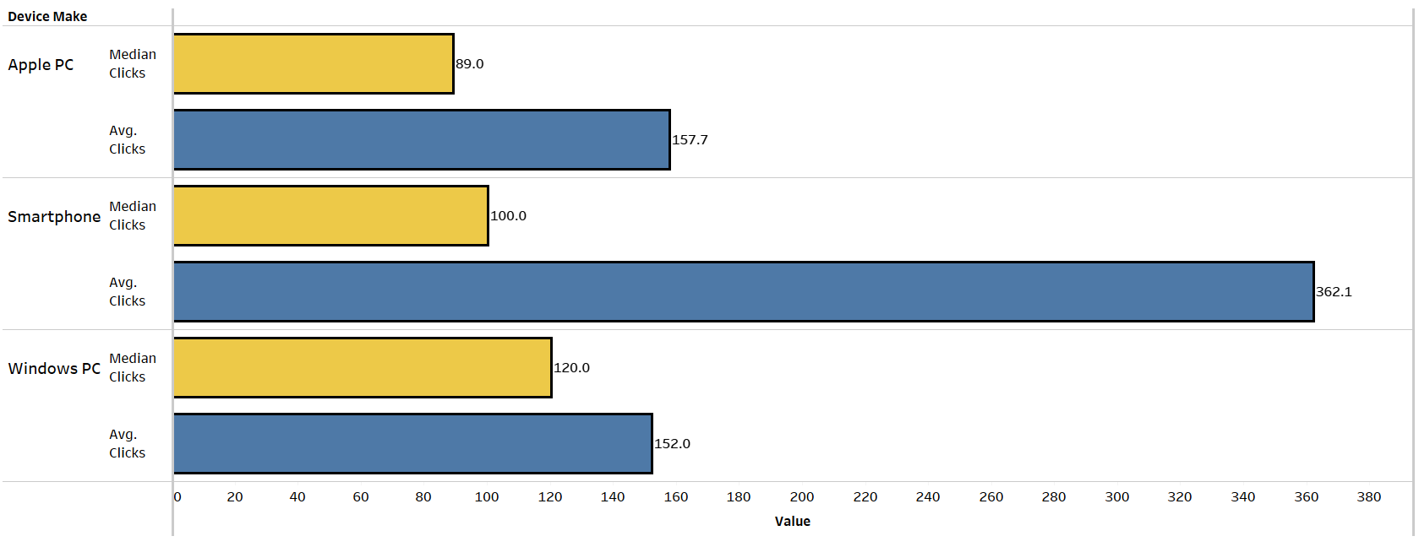
Top performance in clicks
No risk, all rewards
Notes:
As we can see, the median bars show their consistency where Windows PC gets an edge over smartphone device. However, the outliers on smartphone outweighed everything else. I call it… “no risk, all rewards”

Slide 30
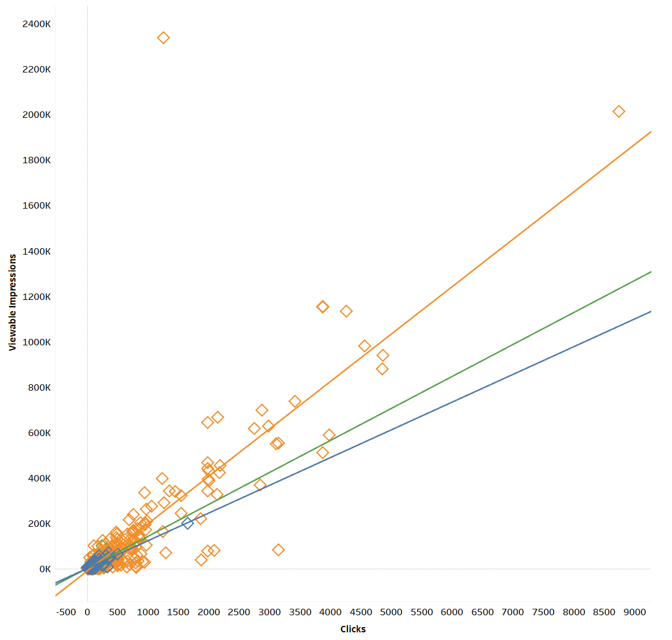
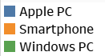
Viewable Impressions vs. Clicks by Device Type
Smartphone shows a lot of impressive outliers over other devices.
All devices are reliably perform indicated by the trend lines.

Slide 31
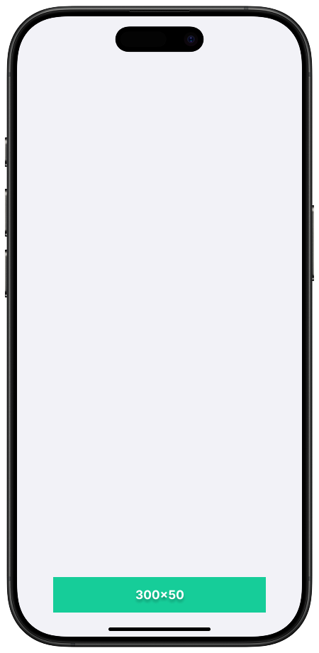
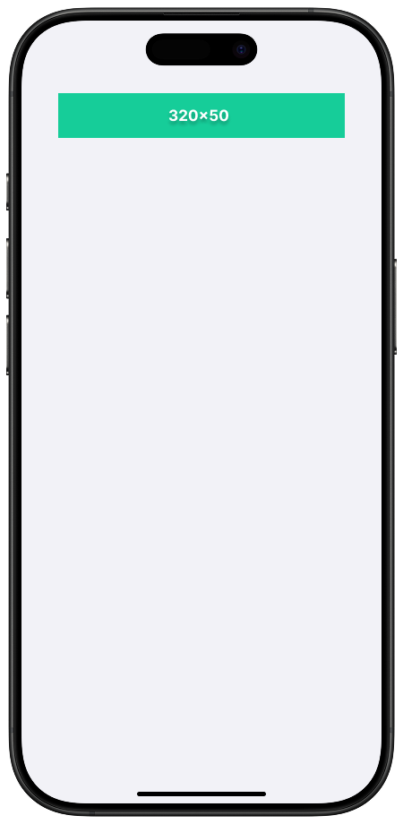
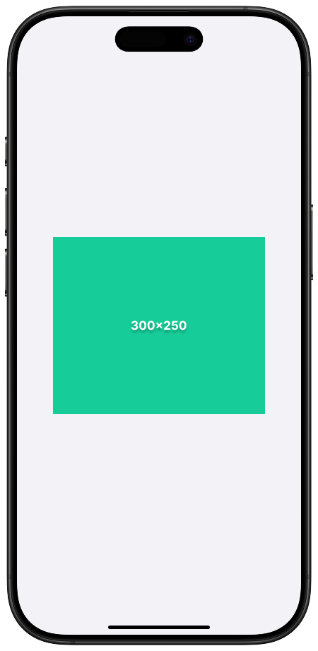
Creative Sizing Reference

Slide 32
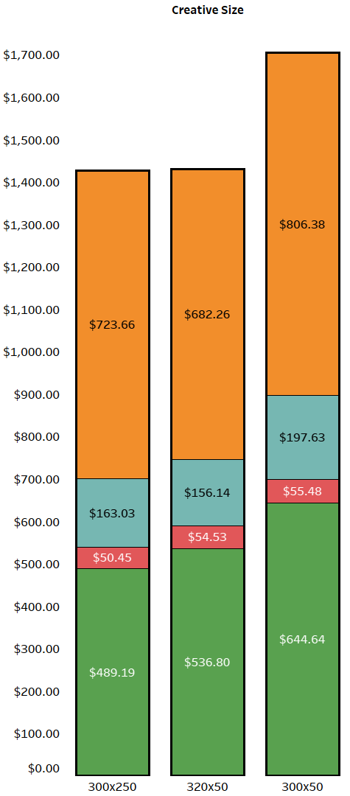
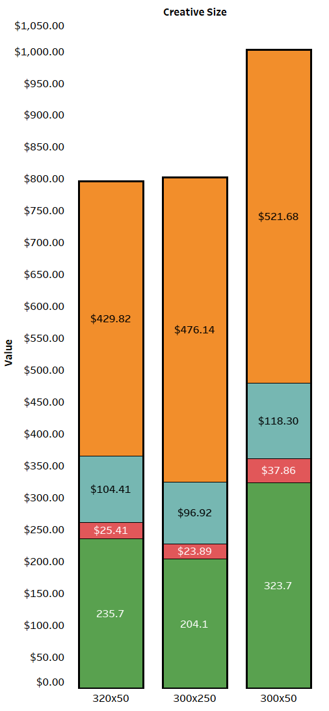
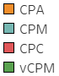
Average
Median
Cost Performance KPIs
The 300x50 creative size is NOT the best choice. Very expensive.

Slide 33
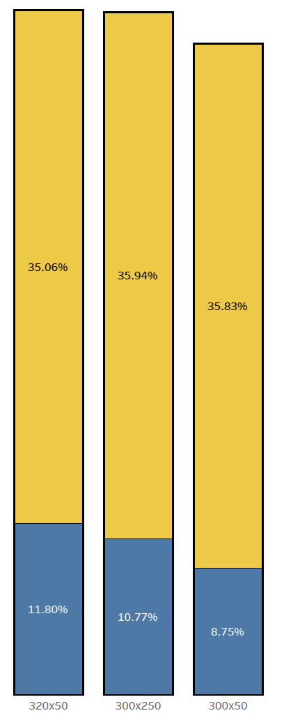
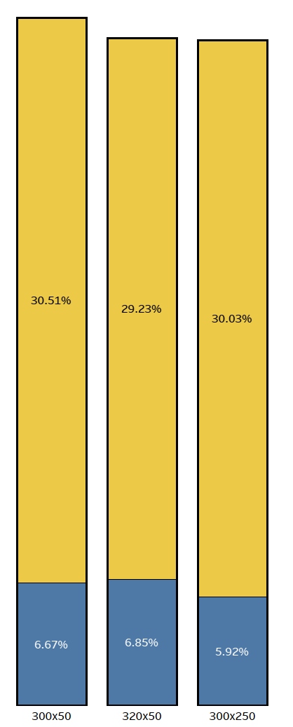
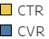
Average
Median
Click Performance KPIs
CTR and CVR are roughly the same across all creative sizes.
Notes:
Even though smartphone devices outperformed with a lot of outliers, we found that Windows PC is the most consistent. However, smartphones have higher chance to outperform without any significant risks

Slide 34
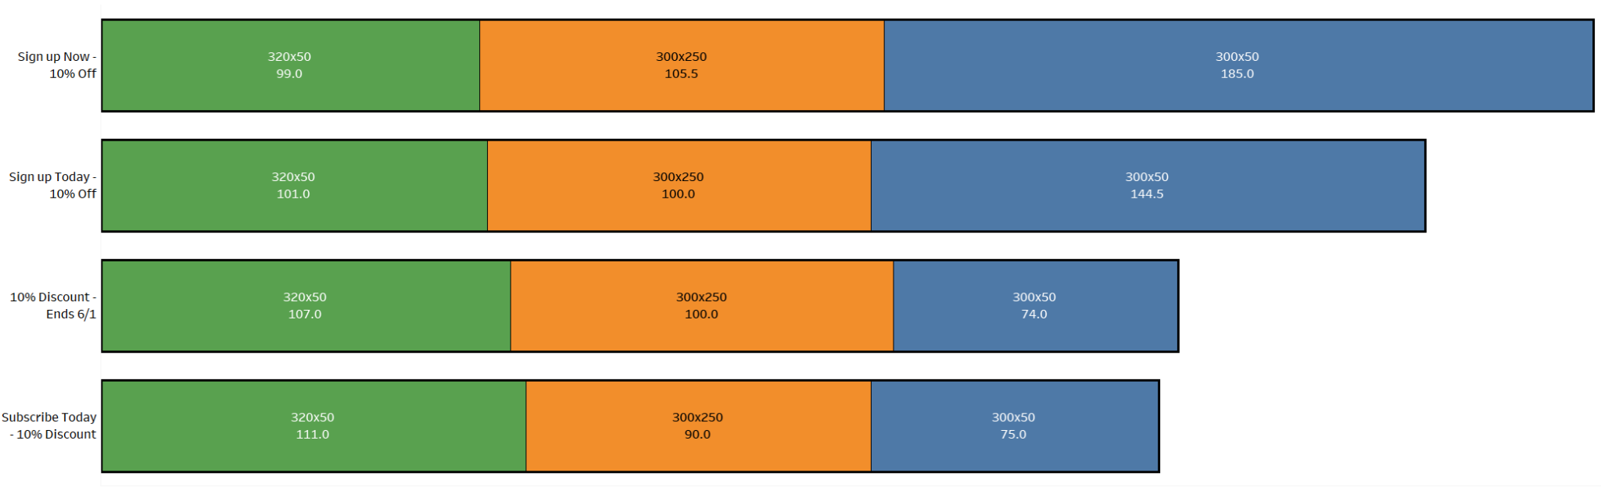
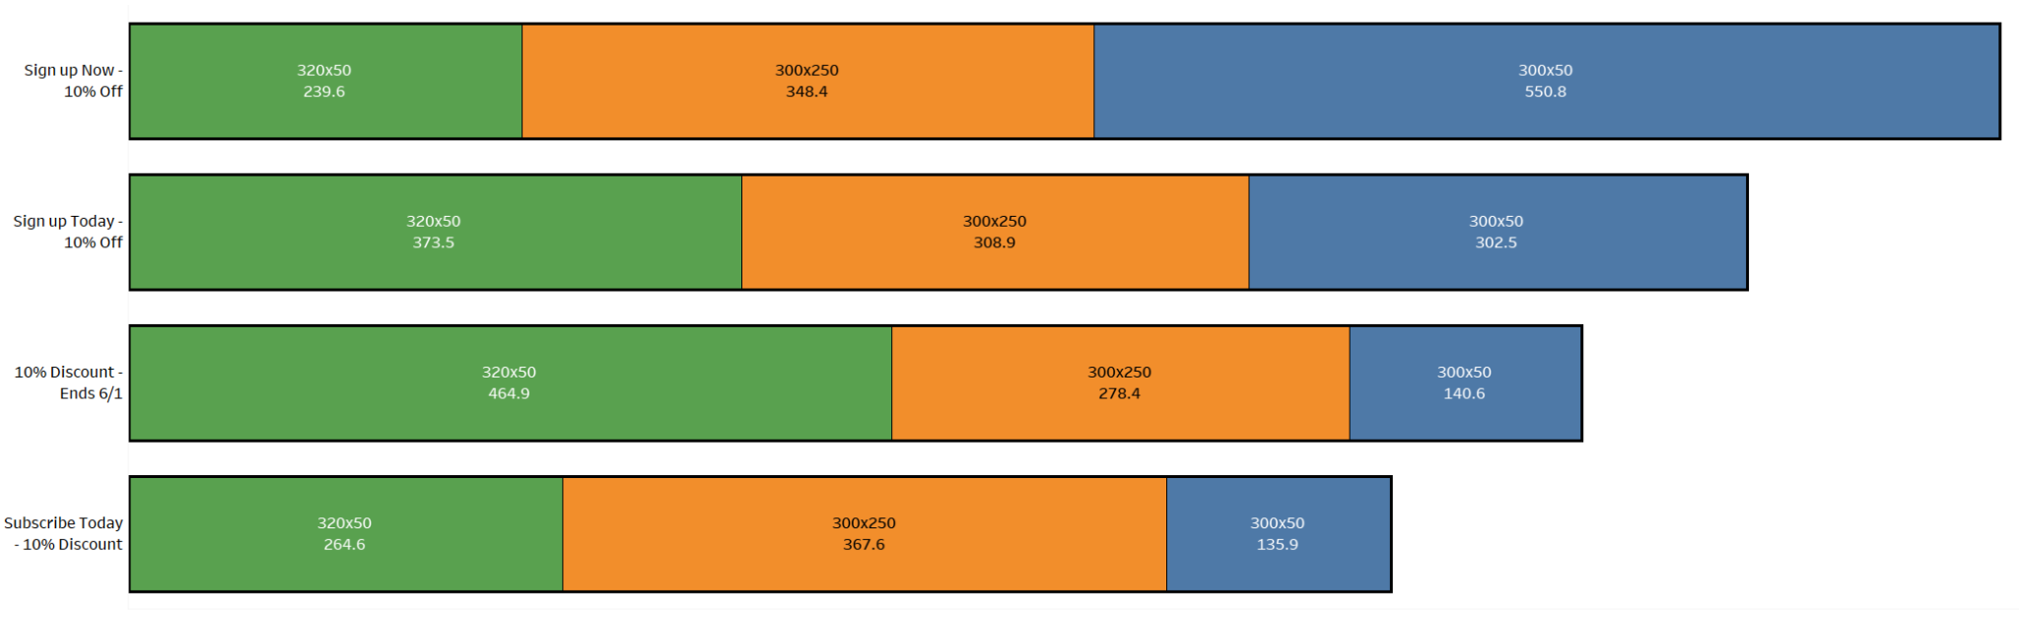
Median Clicks
Creative Message that attracts the most Clicks
Average Clicks
Notes:
Even though smartphone devices outperformed with a lot of outliers, we found that Windows PC is the most consistent. However, smartphones have higher chance to outperform that are impressive enough for a recommendation over Windows PC.

Slide 35
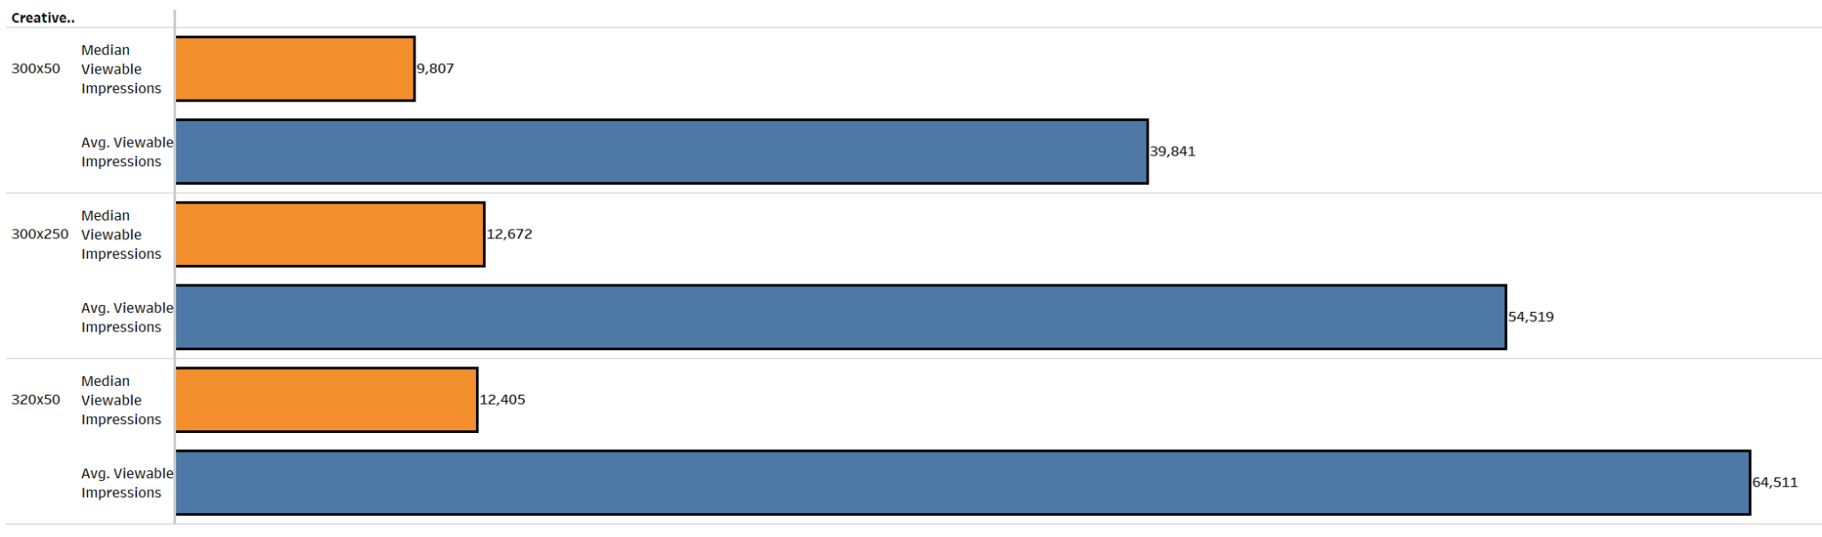
Viewable Impression Performance
Notes:
Even though smartphone devices outperformed with a lot of outliers, we found that Windows PC is the most consistent. However, smartphones have higher chance to outperform without any significant risks

Slide 36
Conclusion
Notes:
Adriana

Slide 37
Improve Campaign performance & spending by:
Divest from campaigns targeting small audience segments
Reduce spending over 300x50 ad size. The performance is not worth the overall costs.
320x50 creative sizing is doing amazingly well on smartphone while staying low on cost overall. We recommend testing it on PC, so the ads will be less intrusive and offer a better user experience.
Further investigate if creative sizing and messaging explains region differences in viewability.

Slide 38
Thank you! Any Questions?

